Slide 1




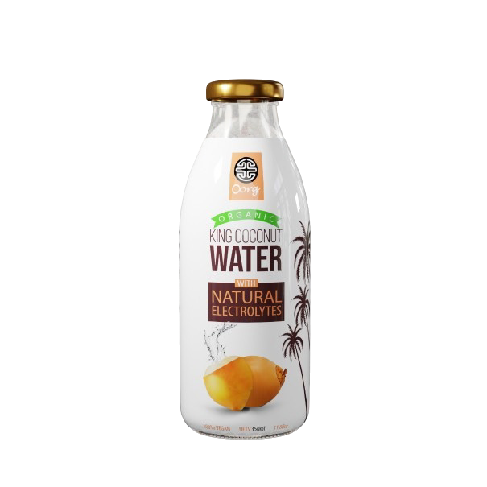
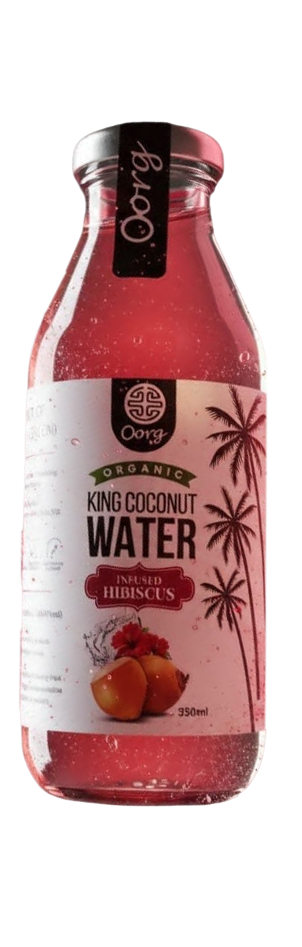

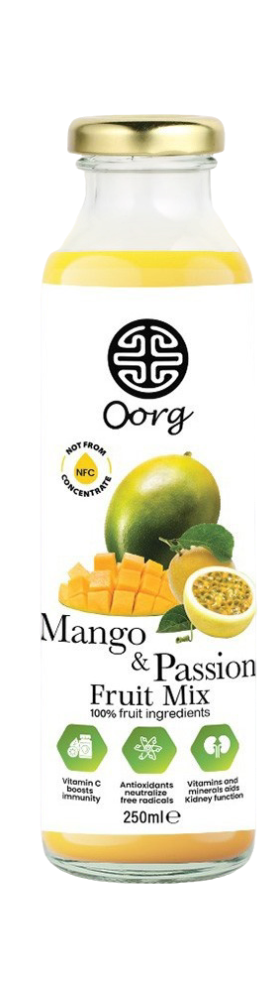
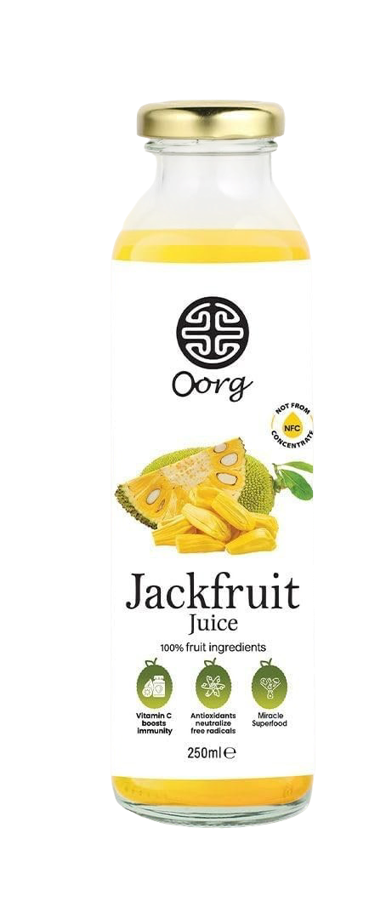
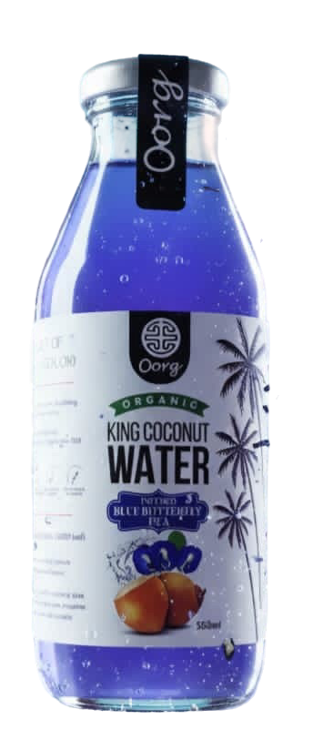
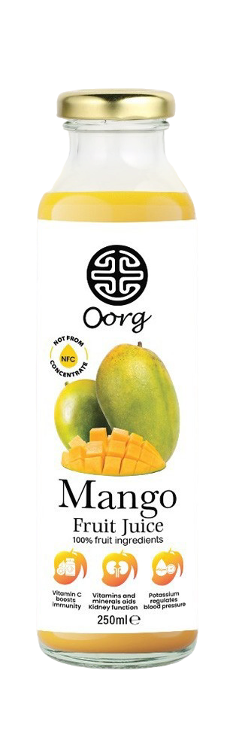
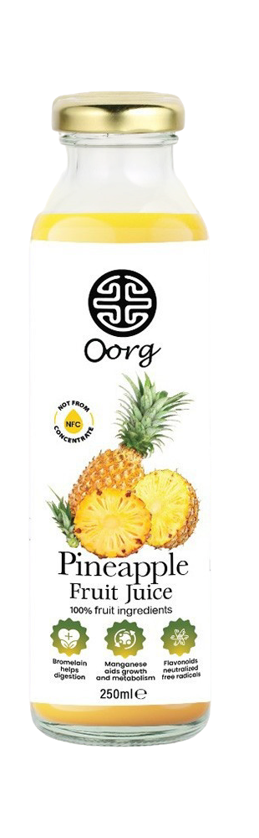
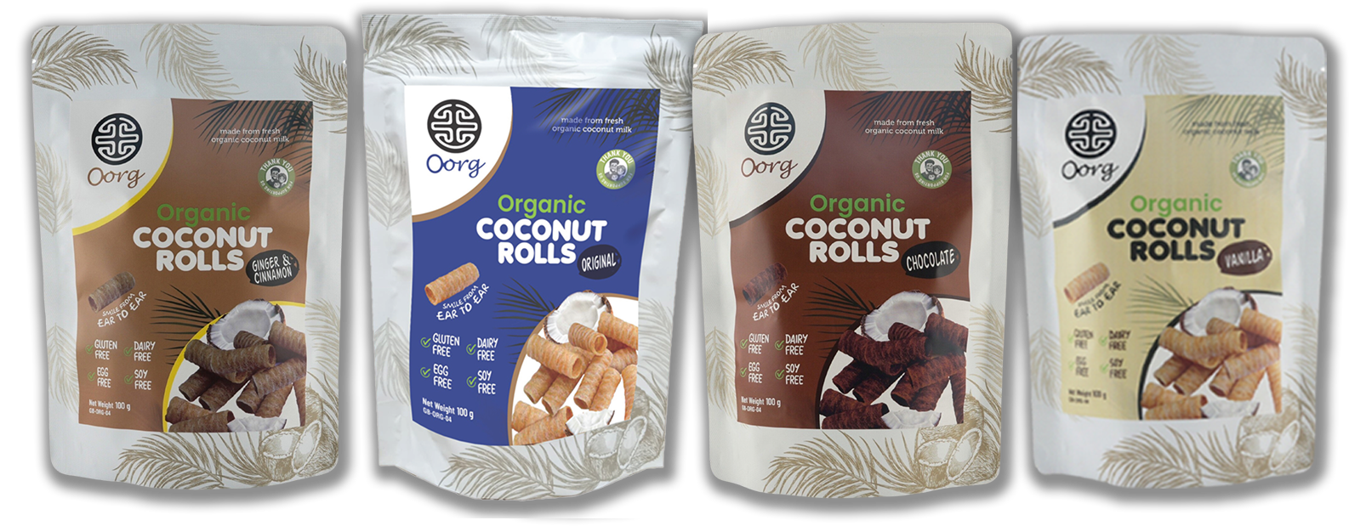
www.oorg.co.uk
Good things Comes in anic
Revolutionizing snacking and hydration with authentic,
organic, and sustainable products

Slide 2
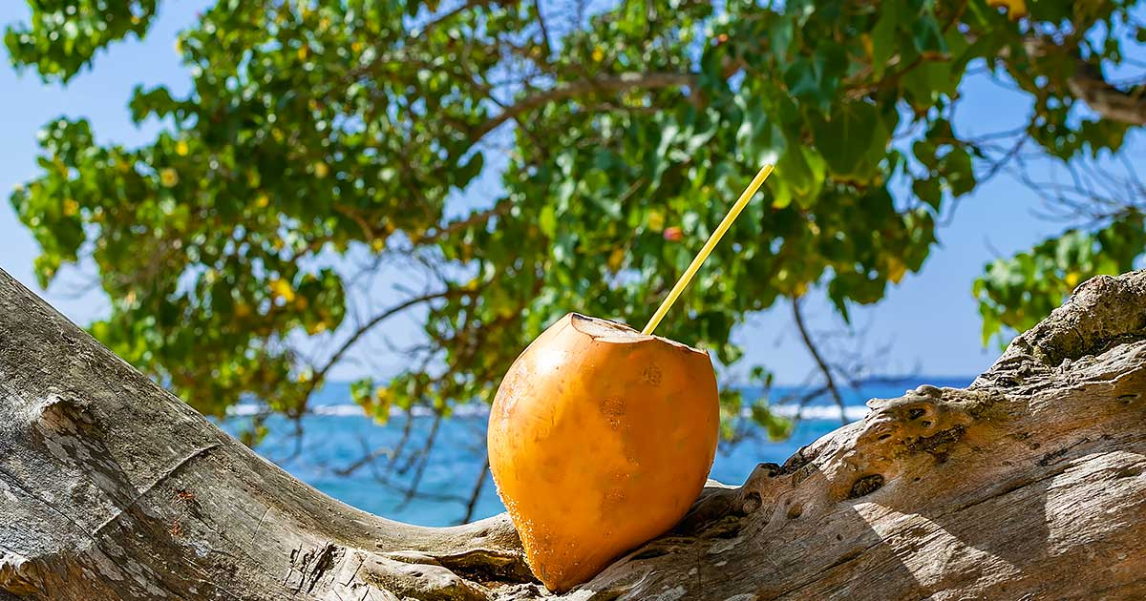
















www.oorg.co.uk
“ORGANIC ORIGINS FOR REAL GOODNESS”
Bringing to the UK organic and natural drinks and snacks
Routes to market
Our customers and online platforms

Slide 3
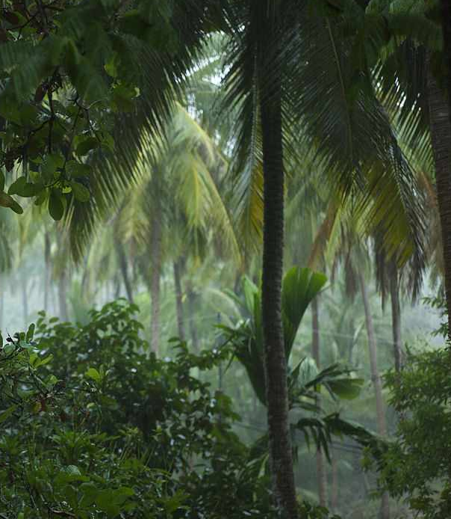

Sustainability is at the heart
Modern agricultural techniques
Giving back to community (supporting local education)
Eco friendly productions
Supporting small scale farmers
ABOUT
HELEBOOMI
PRODUCTS
www.oorg.co.uk

Slide 4

www.oorg.co.uk
PRODUCT PLACEMENT
(Our Customers)
Natural hydration and organic snacking
Allegan free concept
Suitable for anyone
Suitable for hotel mini bars
Foot Ball clubs
On the go snacking
Gyms, cafés, restaurants
End users

Slide 5

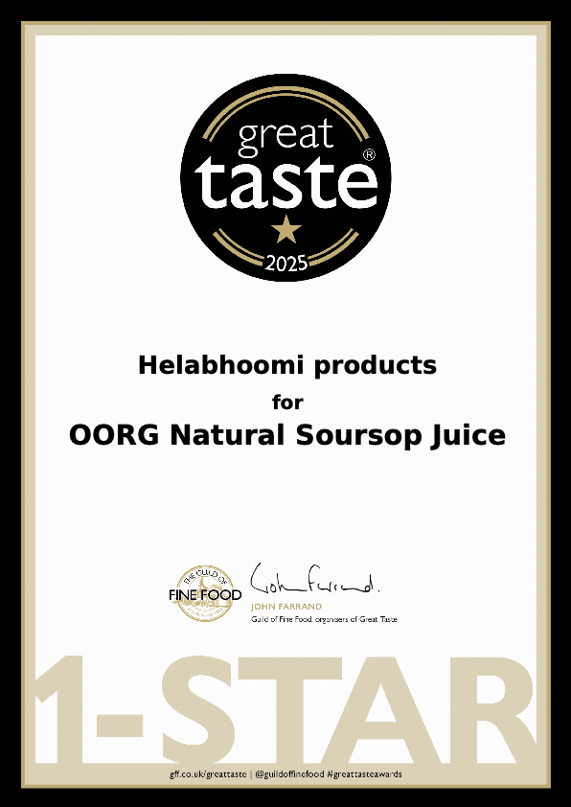
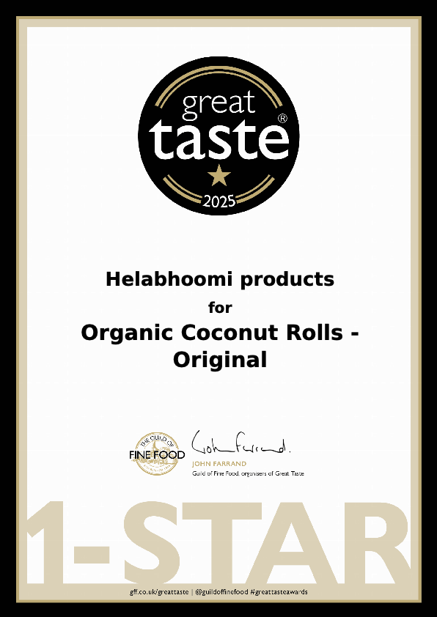
www.oorg.co.uk
Great Taste
Award Winners
2025
(Organic Coconut Rolls &
Natural Soursop Juice)

Slide 6



Oorg – Allergen free
Due-Diligence
www.oorg.co.uk

Slide 7

www.oorg.co.uk
STRENGTHS
Organic king coconut Water
Packed With Natural Electrolytes
Natural electrorytes
High in Pottasium
Sweet & Tangy Flavour
Natural Rejuvernation fruit
Remedy from hangover

Slide 8

www.oorg.co.uk
Organic
King Coconut
Water with
Blue Butterfly Pea
STRENGTHS
Organic king coconut water
Hibiscus & Blue Butterfly Pea Flavors
Blue Butterfly Pea king coconut water
Regualating Diabetes
Good for brain health
Act as a Anti – aging particle
Supports skin with hydration
Rehydration to Eyes
Hibiscus king coconut water
Rich with anti oxidants
Improving liver health and gut health
Immune support
Organic
King Coconut
Water with
Hibiscus
First to the
UK Market

Slide 9
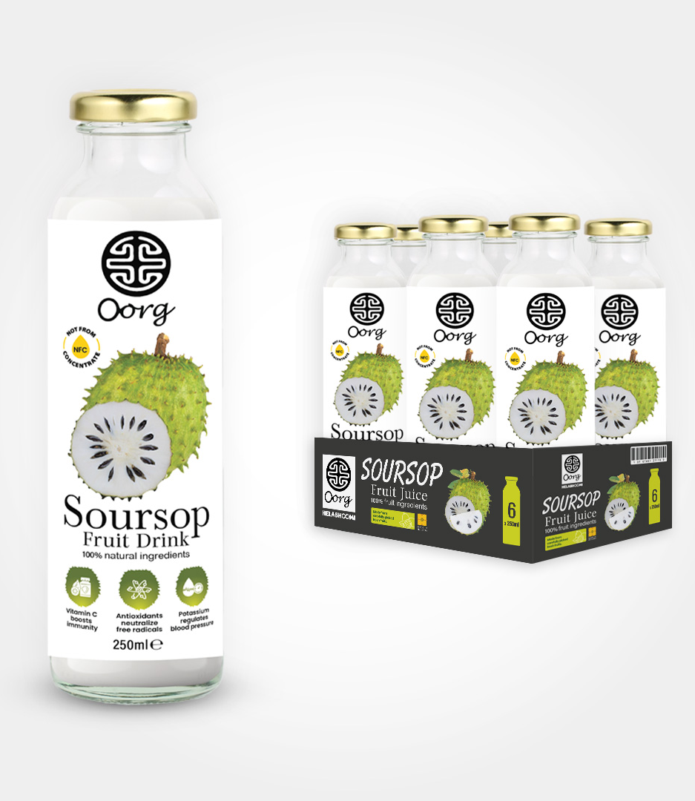
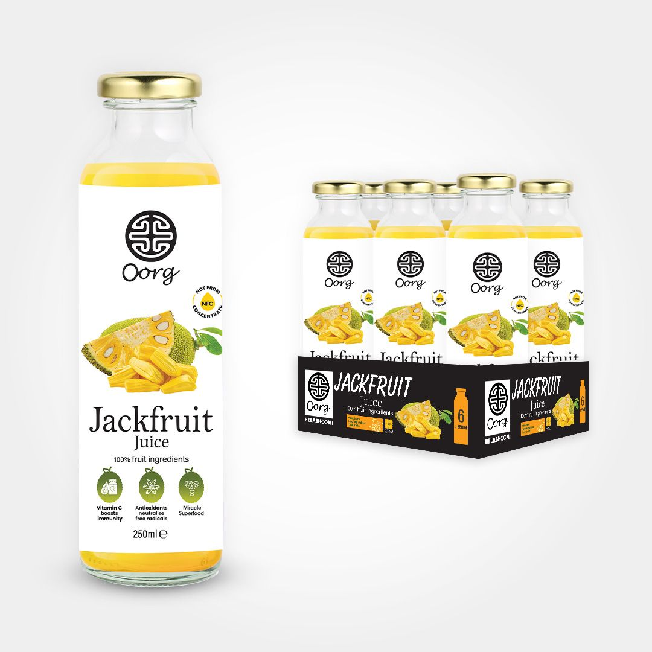
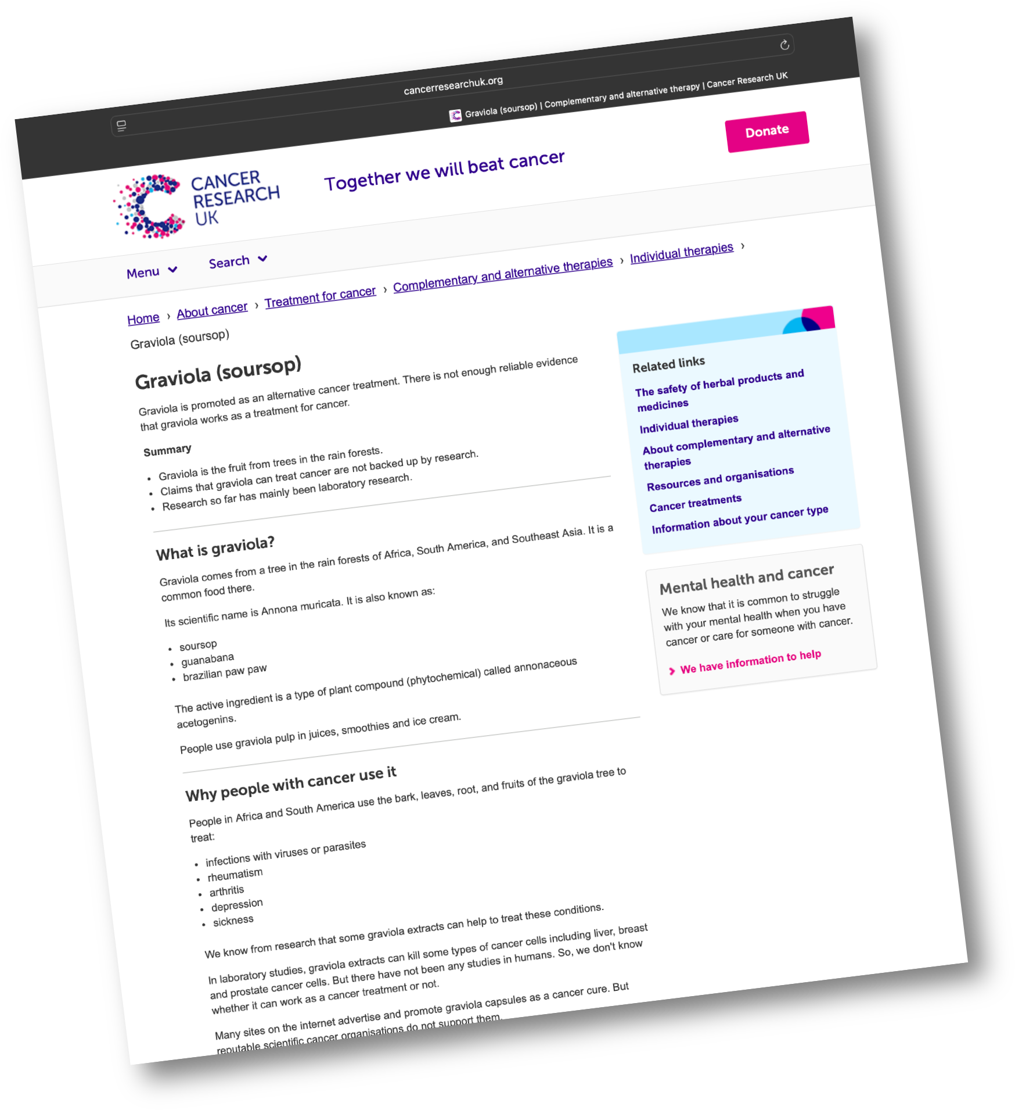
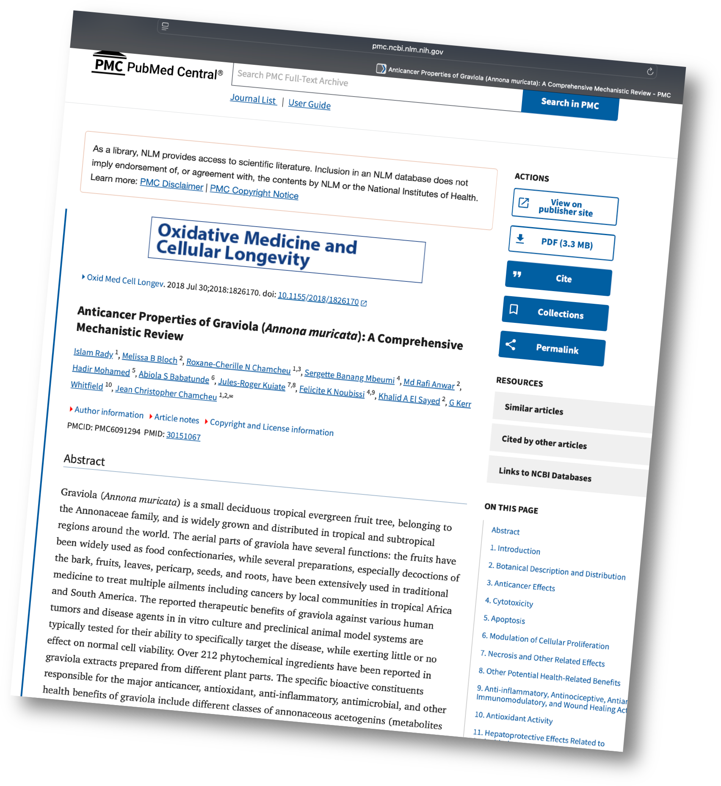
Natural
Soursop
www.oorg.co.uk
Fights cancer cells
Treats stomach ailments
Good for parasite infections
Good for hypertension and
rheumatism
Good for blood purification
Amazon’s Choice
Cancer research UK
Natural
Jackfruit
Can use as a food supplement
High score in vitamins & Minerals
Antioxidant
Support health and boosts immune system
National library of medicine - USA
https://www.cancerresearchuk.org/about-cancer/treatment/
complementary-alternative-therapies/individual-therapies/graviola
https://pmc.ncbi.nlm.nih.gov/articles/PMC6091294/

Slide 10
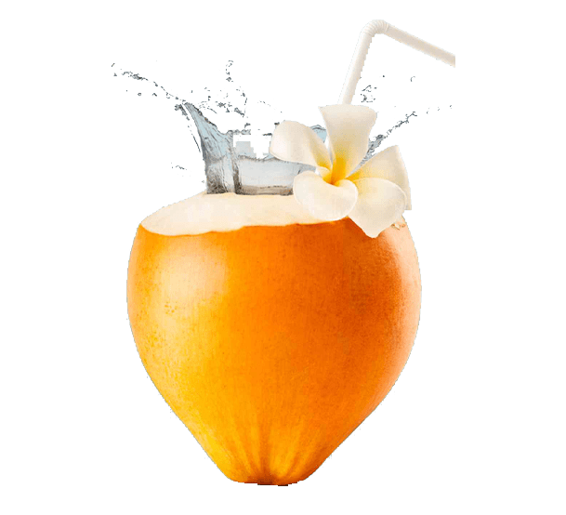
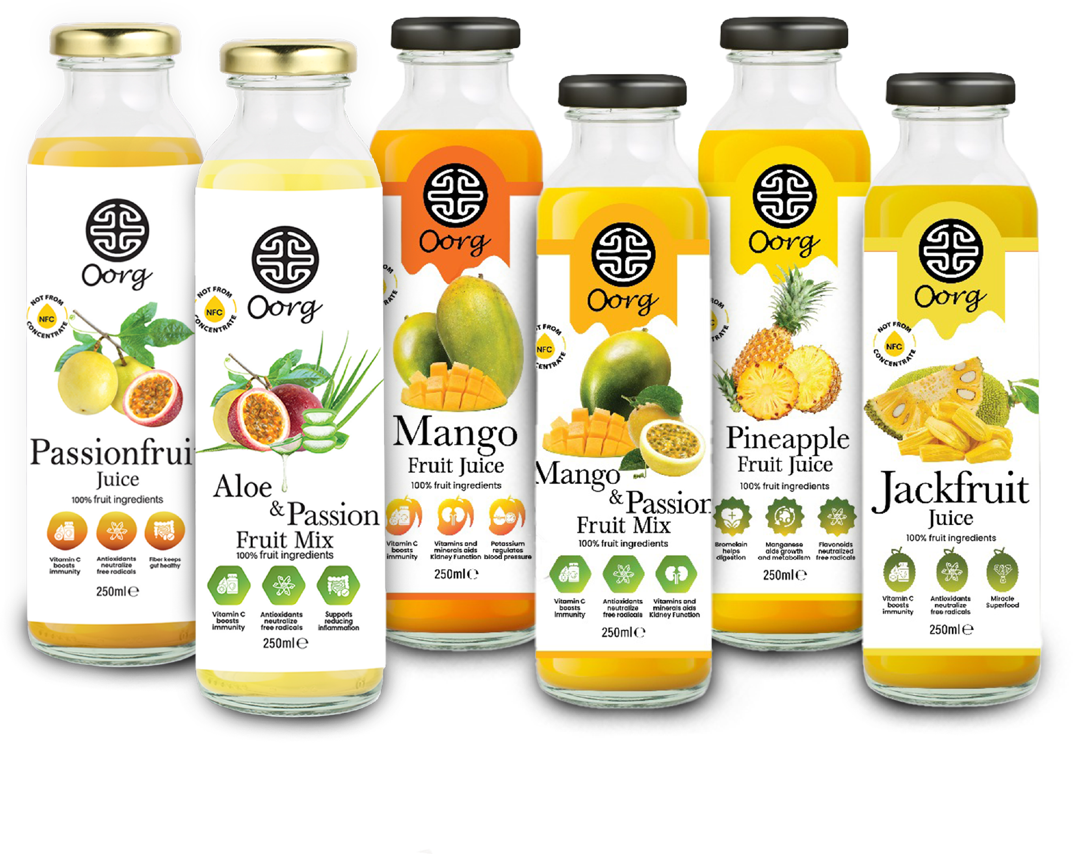
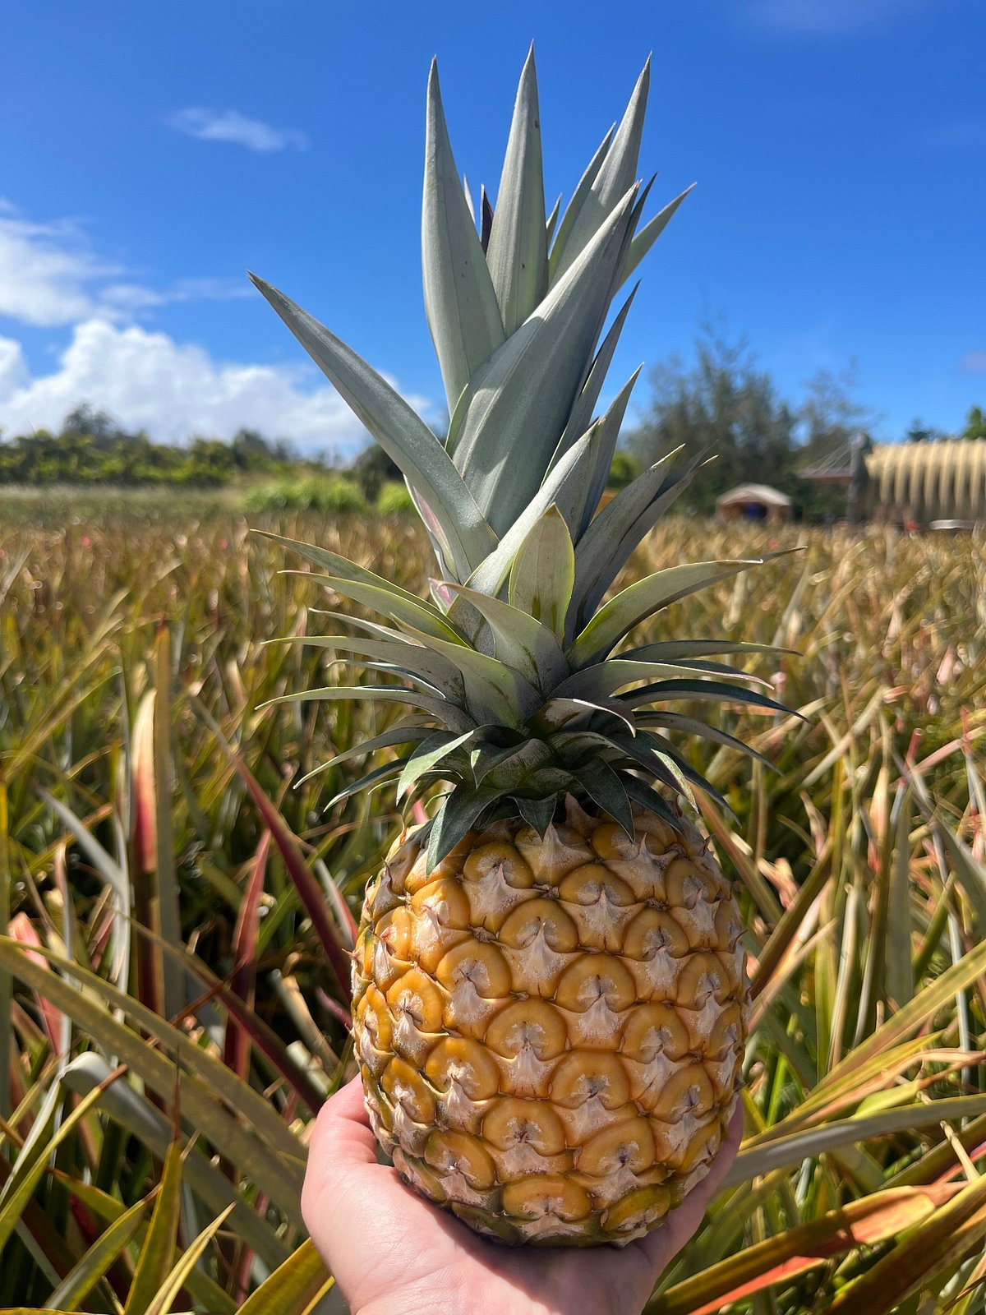
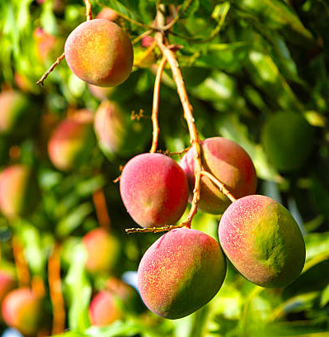
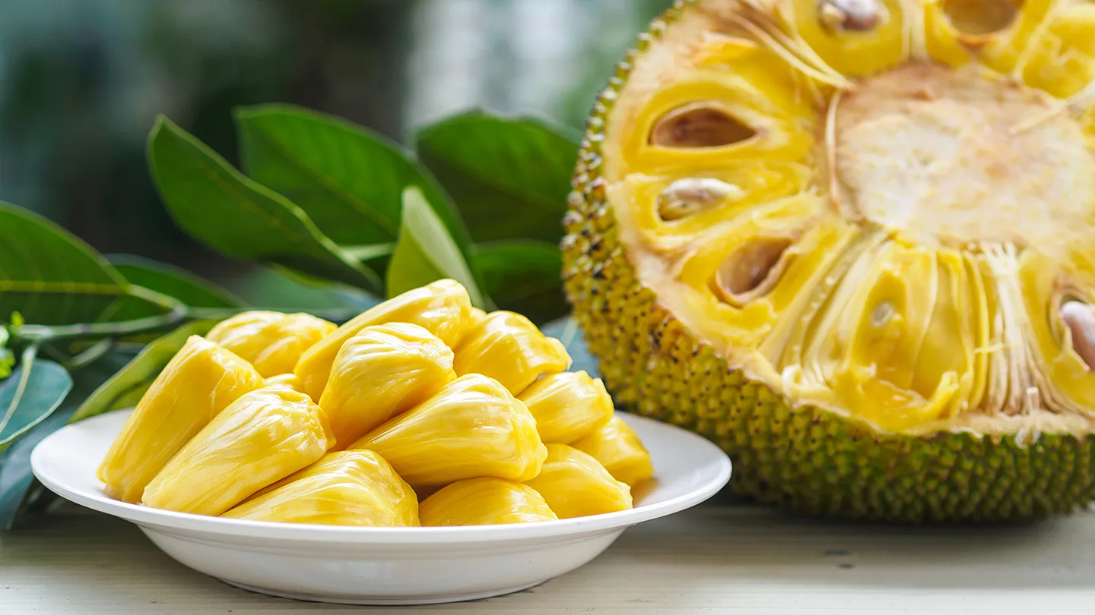
www.oorg.co.uk
DRINKS RANGE
Natural and mostly found in Southeast Asia
Act as High source of Vitamins & Minerals

Slide 11
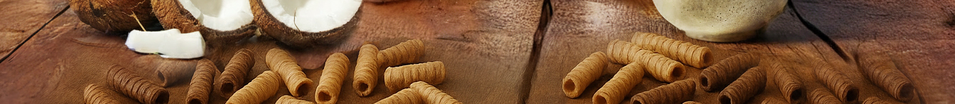

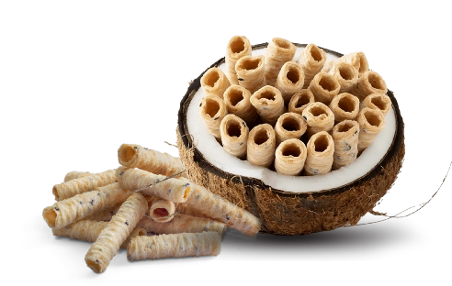

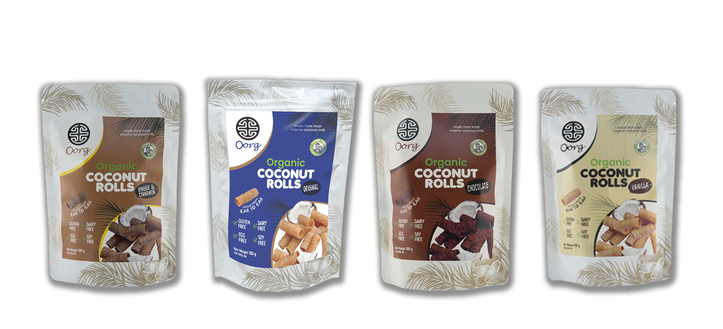

www.oorg.co.uk
www.oorg.co.uk
SNACKS
BUT NOT TASTE FREE,
HIGHLY ADDICTIVE

Slide 12




www.oorg.co.uk
MARKET DRIVES
Soy-free
Ambient (no need for cool storage).
Store at room temperature.
, dairy-free.
Glass bottle — less waste, recyclable.
18-month life cycle
• UK Organic market ~£3.2bn & growing
• Clean-label & functional hydration boom
• Allergen-free & ethical sourcing priority
• Demand for world flavours & authentic brand
• Female Lead

Slide 13

www.oorg.co.uk
New Products
are Coming Soon in 2026

Slide 14

www.oorg.co.uk
RATE OF SALE (JANUARY 2025 UPTO NOW)
Amazon – 32%. [ (Soursop / Jackfruit – 68% , Coconut Rolls – 32%. ) ]
CLF – 47%
Dundeis – 27%
Geared up to scale
UK warehousing

Slide 15



Where OORG Sits vs What They Already Have
www.oorg.co.uk
Brand / Product | Organic | No Refined Sugar | Not From Concentrate | Ambient Shelf Stable | Allergen-Free | Ethical / Social Impact | Award Winning | Packaging
OORG Coconut Water |  |  |  |  |  | ✔ Supports Children | ★ | Eco Carton / Pouch
OORG Soursop / Tropical Juices |  |  |  |  |  | ✔ Supports Children | ★ Great Taste | Glass / PET
OORG Coconut Rolls |  |  | N/A |  |  | ✔ Supports Children | ★ Great Taste | Pouch
Vita Coco | — | — |  |  |  | — | — | Carton
Innocent | — | — |  | ✘ (Chilled) |  | — | — | PET Bottle
Tropicana | — | — | ✘ (Concentrate) | ✘ (Chilled) |  | — | — | Plastic
Deliciously Ella |  |  | N/A |  | ✘ (Oat) |  | — | Bag
Ape Snacks |  |  | N/A |  |  | — | — | Bag

Slide 16
Commercial STRUCTURE
www.oorg.co.uk
Product | RRP | Pack Size
DRINKS | 3.19 GBP | (250ml X 6), (350ml X 6)
SNACKS | 3.69 GBP | 100gm x 12

Slide 17
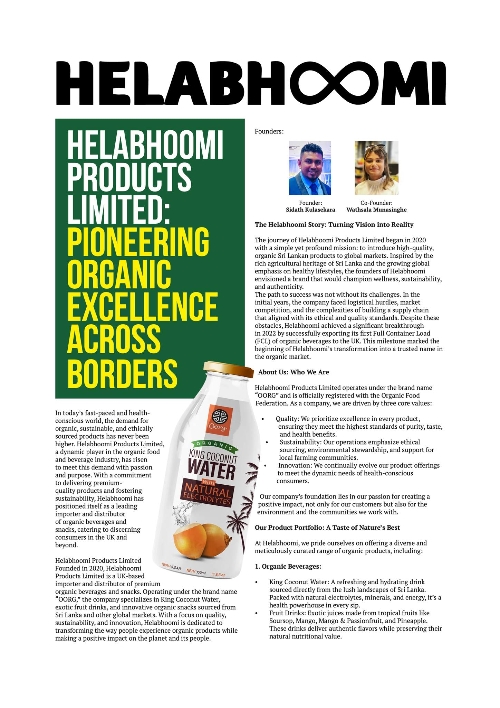

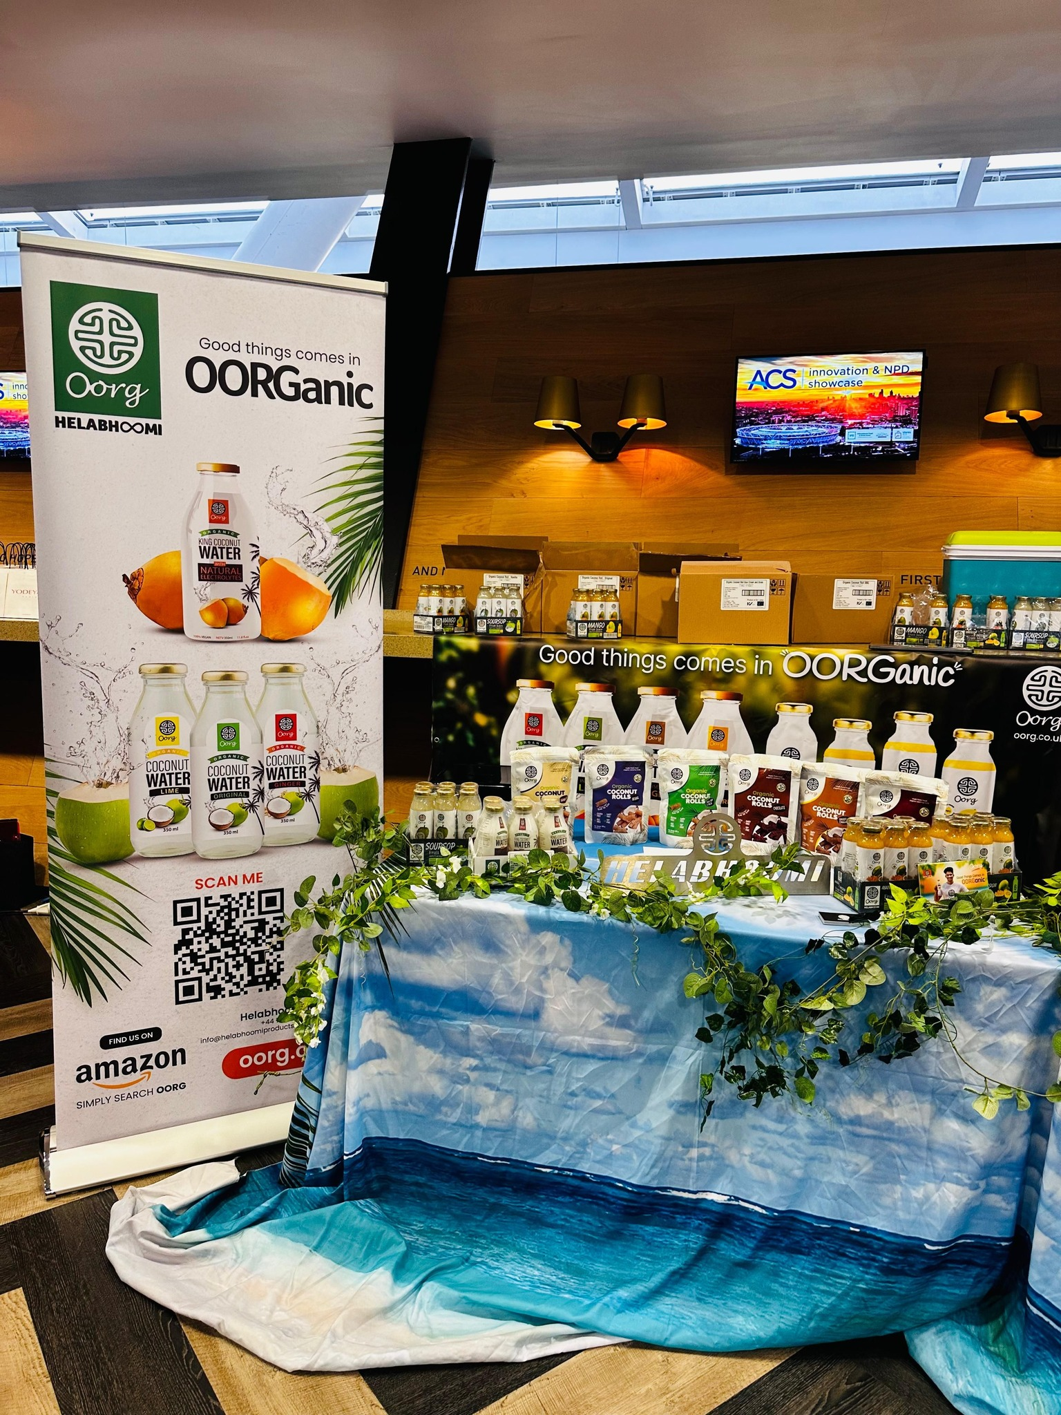
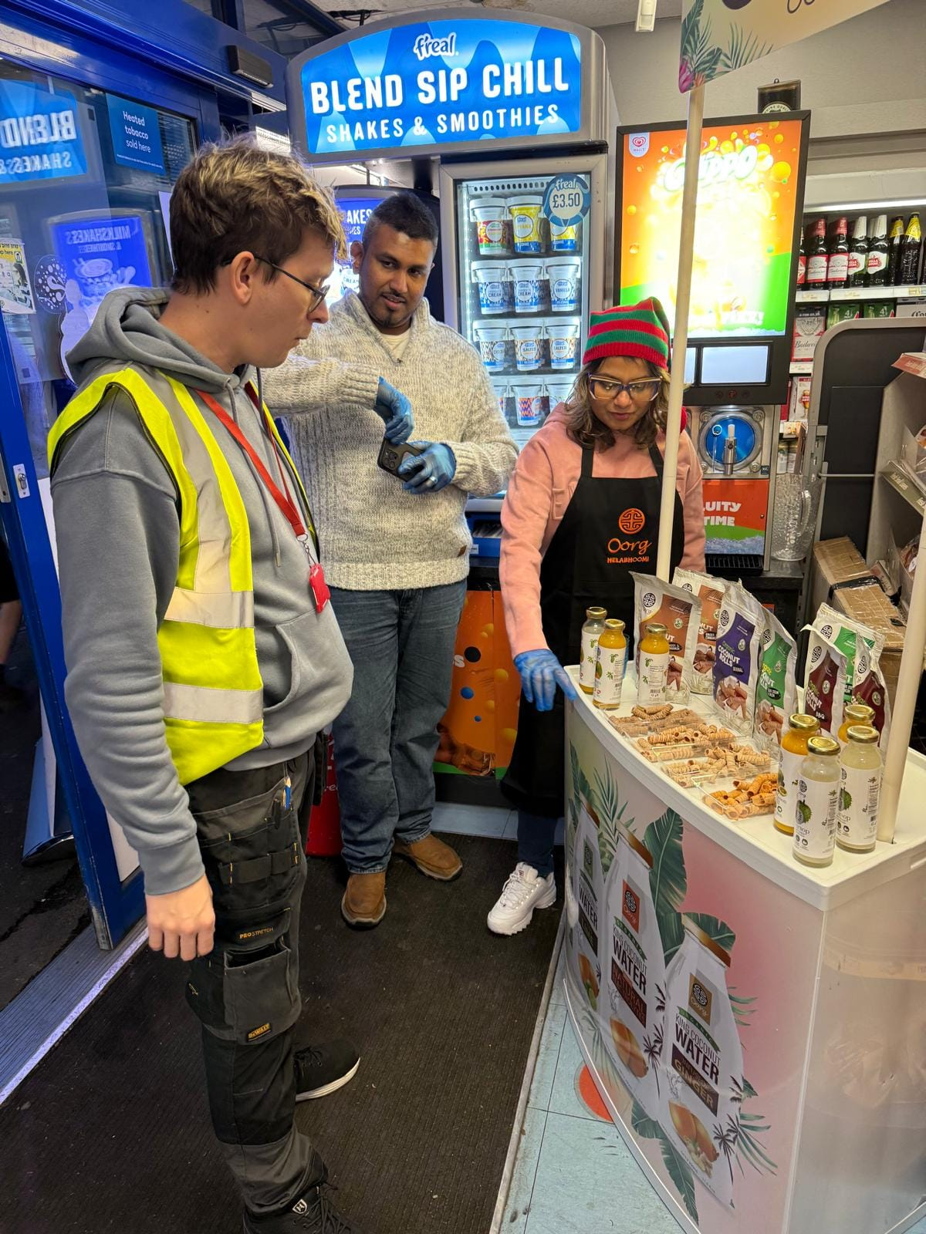
www.oorg.co.uk
MARKETING &
SUPPORT
(How are we collaborating)
➲ Live demos & sampling programs
➲ Influencer partnerships & digital content
➲ RA-RA Days support with Brakes
➲ Joint launch campaigns & training support
➲ Reaching out to BDMs & NAMs and build relationships
➲ Increase Sales via consultants
Your way Field sales consultants
*Oorg is ready to bridge the gaps for breaks in premium organic tropical wellness

Slide 18
www.oorg.co.uk
THANK YOU!

